Slide 1
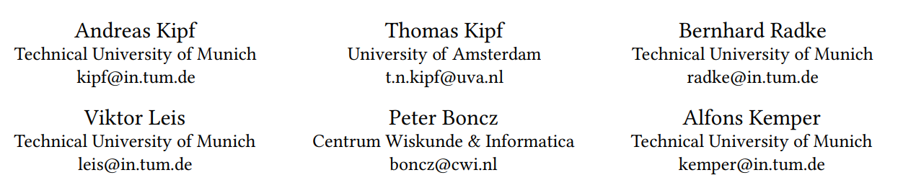
Learned Cardinalities: Estimating Correlated Joins with Deep Learning

Slide 2
Contents
Background
multi-set convolutional network Evaluation
Conclusion

Slide 3
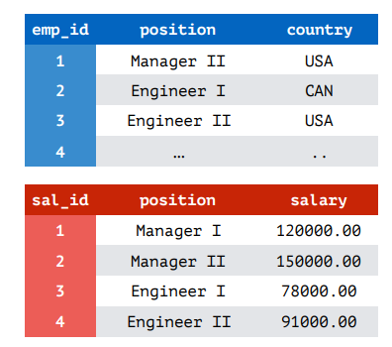
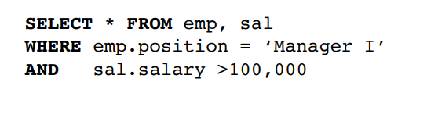
Cardinality
• Given a predicate, query the number of tuples that satisfy this predicate.
• The predicate includes query conditions and joins

Slide 4
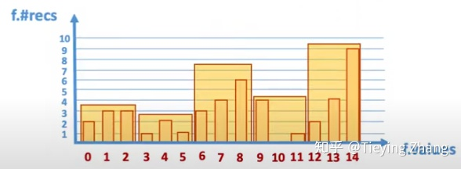
Cardinality estimation
Why we need?
• Query optimization is fundamentally based on cardinality estimation
• The cost model is to get the final cost through cardinality
How we estimate?
• histogram
Column-based statistics

Slide 5
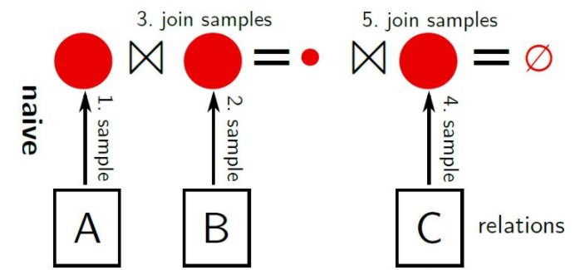
Cardinality estimation
• sampling
random sample + sample join
0-Tuple
The middle sample assembly is very large
causing slow queries and unpredictable performance

Slide 6
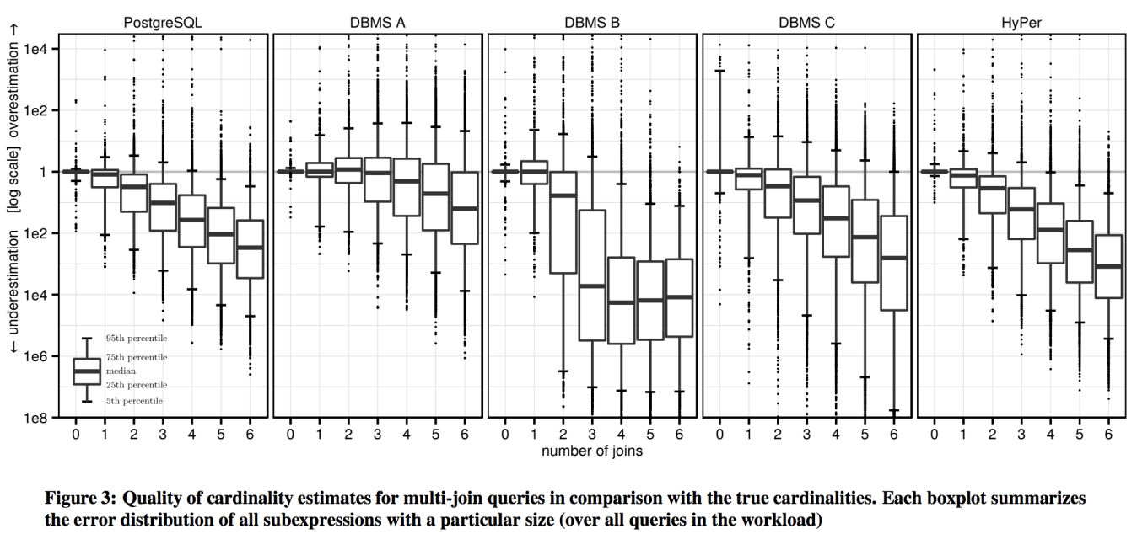
How bad is it?

Slide 7
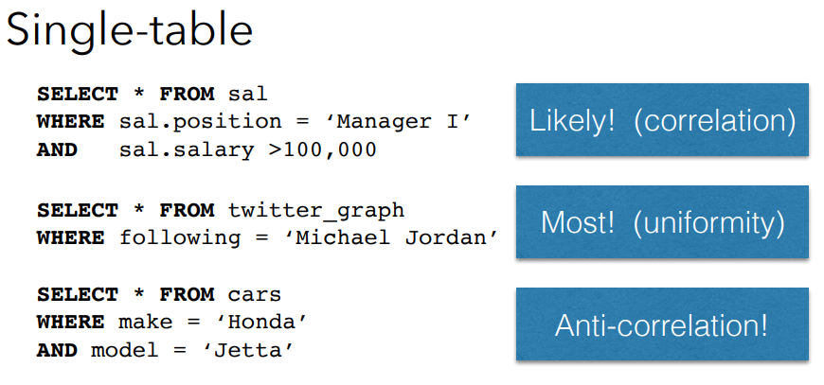
Key ideas
• learns to predict correlations

Slide 8
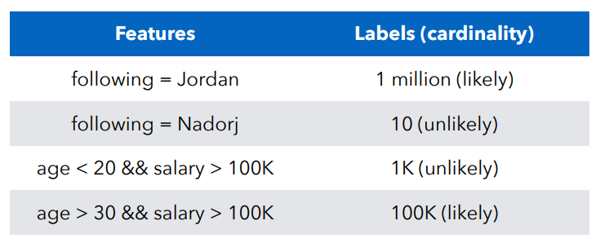
Key ideas
• It should then learn to fix dependent / independence assumptions

Slide 9
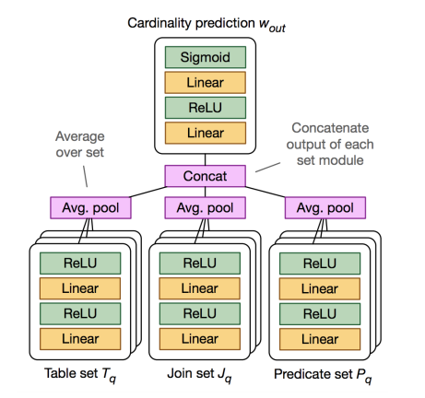
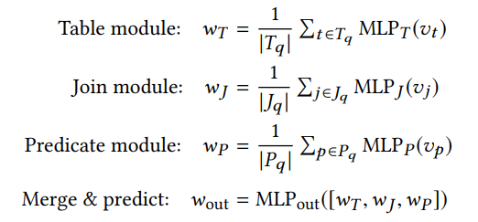
multi-set convolutional network
• Tables, joins, and predicates are represented as separate modules, comprised of one two-layer neural network per set element with shared parameters. Module outputs are averaged, concatenated, and fed into a final output network.

Slide 10
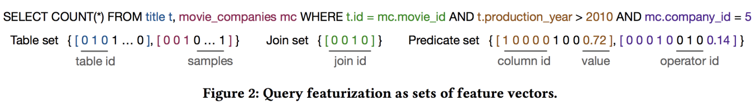
multi-set convolutional network
• each table t is represented by a unique one-hot vector vt(like joins & predicates)
• a bitmap indicating their positions
• operator using a categorical representation with respective unique one-hot vectors
• represent value as a normalized value

Slide 11
multi-set convolutional network
Building our model involves three steps:
• generate random (uniformly distributed) queries using schema and data information
（cold start problem）
• execute these queries to annotate them with their true cardinalities and information
about qualifying materialized base table samples
• feed this training data into an ML model

Slide 12
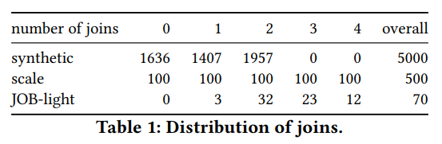
EVALUATION
using the IMDb dataset which contains many correlations and therefore proves
to be very challenging for cardinality estimators
three different query workloads:
• synthetic: the same query generator as our training data
• scale: another synthetic workload with 500 queries designed to show how the
model generalizes to more joins
• JOB-light : a workload derived from the Join Order Benchmark

Slide 13
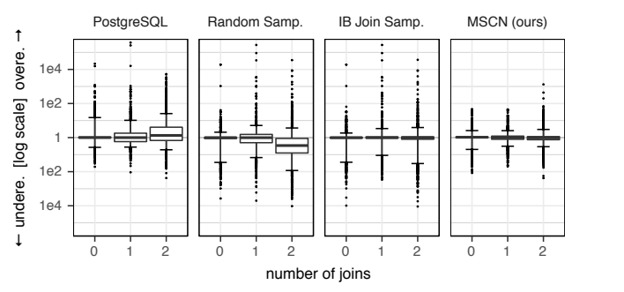
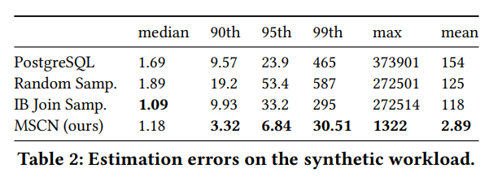
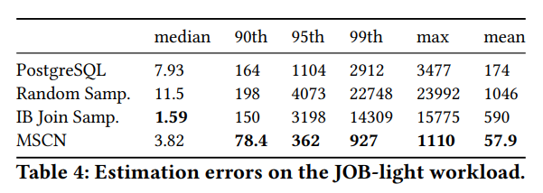
EVALUATION

Slide 14
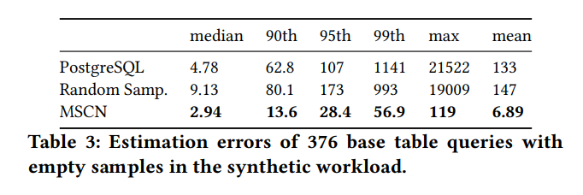
EVALUATION
The difference between MSCN and other random sampling queries in dealing with 0 tuples:
• in RS implementation either using the product of selectivities of individual conjuncts or using the number of distinct values of the column with the most selective predicate.
• MSCN can use the signal of individual query features (in this case the specific table and predicate features) to provide a more precise estimate.

Slide 15
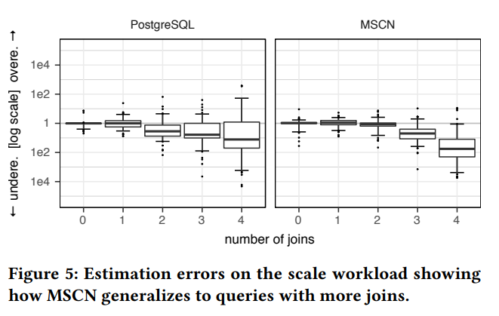
EVALUATION
Generalizing to More Joins:
• From two to three joins, the 95th percentile q-error increases from 7.66 to 38.6. To give a point of reference, PostgreSQL has a 95th percentile q-error of 78.0 for the same queries

Slide 16
Conclusion
advantage:
• correlation
• 0-tuple
• the size of model
disadvantage:
• complex predicates
• more joins
• adaptive training

